Slide 1
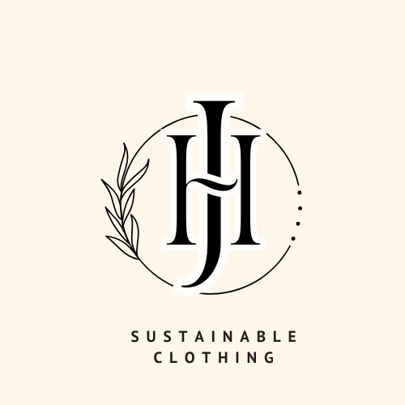

Slide 2
Who We are
HOW?
WHY?
WHAT?
We want to pursue the JEHA business idea because Starting a sustainable clothing business is not just about tapping into a growing market trend; it is about making a meaningful difference in the world. By prioritizing ethical practices, environmental stewardship, and economic viability, you can create a business that is not only successful but also contributes positively to society and the planet
The JEHA venture focuses on Recycling PET plastic bottles into clothes is a sustainable solution that addresses critical environmental and social issues. By transforming waste into valuable products, the project not only reduces plastic pollution but also promotes a circular economy, paving the way for a more sustainable future in fashion.
JEHA addresses The project of recycling PET plastic bottles into clothes addresses significant environmental challenges by reducing plastic waste and lowering resource consumption. By leveraging market demand for sustainable products and exploring various revenue streams, the project not only contributes to environmental sustainability but also establishes a viable and profitable business model
.

Slide 3
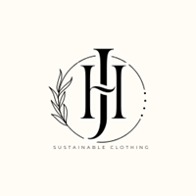
Problem / opportunity
CONTEXT When does the problem occur? | PROBLEM What is the root cause of the problem? | ALTERNATIVES What do customers do now to ﬁx the problem?
CUSTOMERS Who has the problem most often? | EMOTIONAL IMPACT How does the customer feel? | ALTERNATIVE SHORTCOMINGS What are the disadvantages of the alternatives?
 | QUANTIFIABLE IMPACT What is the measurable impact (include units)?
Currently, customers may purchase clothing from brands that claim to be sustainable or engage in small-scale recycling (e.g., donating or upcycling clothes). Some also opt for second-hand shopping to reduce demand for new clothing.
The problem occurs during the production and disposal phases of clothing. The fashion industry generates substantial waste and pollution, particularly when clothes are produced from virgin materials and discarded after short use.
The root cause is the reliance on non-renewable resources (e.g., petroleum-based fibers) and inefficient recycling methods, leading to massive environmental degradation.
Customers may feel frustrated, guilty, or helpless due to the difficulty in finding truly sustainable options and the lack of transparency in the fashion industry.
Environmentally-conscious consumers, especially those looking for genuinely sustainable clothing options. Additionally, companies in the fashion industry aiming to meet sustainability goals face this problem.
Alternatives like second-hand shopping or limited sustainable lines from major brands may not fully address the environmental impact. These alternatives can also be less appealing due to higher costs, limited availability, and concerns about the actual sustainability of the products.
The impact can be measured in terms of reduced carbon footprint (e.g., kilograms of CO2 emissions saved), reduced waste (e.g., tons of textiles diverted from landfills)

Slide 4
Problem Interviews And Surveys Results
How many customers did you interview?
What was the interview mode?
How many of them agree this is a problem and wants a solution?
How many of them said they don't need a new solution?
10 customers (20%) stated that they do not feel the need for a new solution
50 customers
30 interviews were conducted online, and 20 interviews were conducted in person
40 customers (80%) agreed that this is a problem and expressed a desire for a new solution

Slide 5

Market Size Estimation
How to calculate market size?
1. Start with Total Addressable market- $50billion
TAM refers to the total market demand for a product or service.
If you’re entering a pre-existing space (like small business banking) you can research it and provide credible sources or reference points on how you arrived at the TAM. If you’re creating a new product or space (like Slack), you can estimate the number of customers that would want your product and approximate how much you could charge them.
2. Take your target market (SAM), within that TAM, which varies depending on geography and other logistical factors. Determine the penetration potential of your target market. This is the portion of the market you can reasonably compete with $20million
3.By conducting research with existing competitors, distributors etc., understand the likely penetration rate 10%
4. Multiply target market by penetration rate to find your market size $2million
TAM
$50billion
SAM
$20m
SOM
$2million

Slide 6


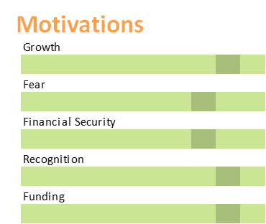
Customer Persona
Perseverance
Knowledgeable
Experienced
Photo
Goals
Personal Goals: To live a more sustainable lifestyle and minimize her environmental footprint
Aspirations: To influence others to adopt sustainable practices and make informed purchasing decisions
Frustrations
Problems: Difficulty finding truly sustainable products that are also stylish and affordable
Needs: High-quality, eco-friendly clothing that aligns with her values
Name: Sarah Thompson
Age: 32
Gender: Female
Income Level: $65,000 per year
Education: Bachelor’s degree in Marketing
Occupation: Marketing Manager
Bio
Psychographics:
Interests: Yoga, travel, and organic food
Values: Sustainability, quality, and ethical practices
Lifestyle: Health-conscious, enjoys outdoor activities, and prefers eco-friendly products
Behavioral Traits:
Shopping Habits: Prefers online shopping with detailed product reviews, looks for brands with sustainable practices
Technology Use: Active on social media (Instagram, Pinterest), uses a smartphone for most online interactions
Brand Preferences: Favors brands known for their commitment to sustainability and ethical production
Personality

Slide 7
Value Proposition Canvas
.
.
I would LOVE it if:
Gains: What benefits or positive outcomes do customers seek? These can include functional gains, social benefits, or emotional rewards.
Example: Feeling good about contributing to environmental sustainability, receiving compliments on stylish clothing, or feeling part of a community.
Gain Creators: How does your product or service enhance the customer’s gains or provide additional benefits?
Example: Positive brand image associated with sustainability, unique and trendy designs, and loyalty programs..
Products and Services: What are the key features and offerings of your product or service?
Example: Eco-friendly fabrics, transparent supply chain, and stylish designs.
I would WANT:
Jobs: What tasks or problems are customers trying to accomplish or solve? This could be functional, social, or emotional tasks.
Example: For a sustainable clothing brand, a customer job might be finding stylish, eco-friendly clothing that fits their lifestyle.
GAIN CREATORS
GAINS
PRODUCT/
SERVICE
JOBS
PAIN KILLERS
PAINS
Pain Relievers: How does your product or service alleviate the pains identified in the customer profile?
Example: Affordable pricing strategies, high-quality materials, and accessible product lines.
I would HATE it if:
Pains: What are the obstacles or negative experiences customers face while trying to complete their jobs? These include frustrations, obstacles, or risks.
Example: High cost of sustainable clothing, lack of availability, or poor quality.

Slide 8
solution
List the Benefits of Your solutions
Environmental Impact:
Reduces Waste: Diverts plastic bottles from landfills and oceans.
Conserves Resources: Lowers the need for new raw materials and reduces energy consumption compared to producing virgin fibers.
Sustainability:
Lower Carbon Footprint: Production of recycled fibers generally has a smaller carbon footprint than conventional textile manufacturing.
Resource Efficiency: Makes use of existing plastic waste, supporting a circular economy.
Economic Benefits:
Cost-Effective: Recycled materials can be cheaper than virgin materials, potentially lowering production costs.
Job Creation: Creates jobs in the recycling and manufacturing sectors.
Consumer Appeal:
Eco-Friendly Product: Appeals to environmentally conscious consumers seeking sustainable fashion choices.
Innovative Design: Offers unique and modern designs that attract style-conscious buyers.
Educational Value:
Raises Awareness: Highlights the importance of recycling and sustainability, encouraging broader adoption of eco-friendly practices.
Brand Differentiation:
Competitive Edge: Positions brands as leaders in sustainability, differentiating them in a crowded market.
Describe your Solution:
Our solution for sustainable clothing addresses environmental and ethical concerns in the fashion industry by offering a line of eco-friendly apparel that combines style, quality, and sustainability. We focus on minimizing environmental impact and promoting ethical practices while delivering fashionable, high-quality garments.
The details of our offering consist of:
Eco-Friendly Materials
Ethical Production
Sustainable Manufacturing Processes
Design and Innovation
Customer Engagement and Education

Slide 9

Competition Analysis
Benefits | Patagonia | Adidas | H&M Conscious Collection | Traditional Apparel Brands | JEHA
Product | Uses recycled polyester from plastic bottles in its clothing. | Collaborates with Parley for the Oceans to produce shoes and apparel from recycled ocean plastic. | Offers garments made from recycled materials, including polyester. | Conventional clothing brands that might introduce eco-friendly lines but aren’t solely focused on recycled materials. | use PET plastic bottles and old clothes recycled them in designer clothes
Price | high | Integrated into Amazon Prime membership | Competitive pricing model | affordable | affordable
Branding channels | health organizations, government collaborations | Amazon's extensive e-commerce platform | Google and Alphabet branding | Industry conferences | Social media
Packaging | Specialized packaging | Standardized Amazon packaging | Lightweight and eco-friendly packaging | Specialized containers | Eco-friendly and secure packaging
Market reviews | Generally positive, especially in remote areas | Mixed reviews | Positive reviews | Generally positive | Anticipated positive reception
UVP | Fast and reliable delivery | Rapid | Quick and eco-friendly delivery | Efficient and reliable transport | Sustainable,
Add more as required

Slide 10
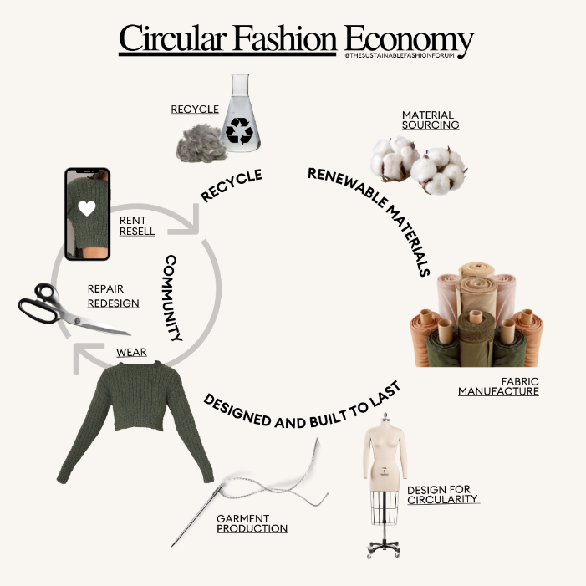
Lean Canvas
EXISTING ALTERNATIVES
SOLUTION
Sustainable clothing made from 50% recycled clothes and 50% PET plastic bottles.Doped dyeing method to minimize environmental impact and ensure vibrant, long-lasting colors.Affordable pricing to make eco-friendly options accessible
UNIQUE VALUE PROPOSITION
True sustainability by repurposing waste materials and using eco-friendly dyeing processes.Innovative and stylish designs that don't compromise on aesthetics or durability.Transparency in sourcing and manufacturing processes
HIGH-LEVEL CONCEPT
Sustainable fashion redefined: High-quality, stylish clothing made from recycled materials, using eco-friendly processes that are affordable and accessible.
UNFAIR ADVANTAGE
Exclusive use of doped dyeing in combination with recycled materials.Strong brand commitment to sustainability and ethical practices.Partnerships with recycling programs to ensure a steady supply of materials.
CUSTOMER SEGMENTS
Environmentally-conscious consumers seeking sustainable fashion options.Young adults and millennials who prioritize ethical and eco-friendly brands.Fashion enthusiasts interested in unique, innovative clothing.
EARLY ADOPTERS
Eco-conscious consumers already buying sustainable products.Fashion-forward individuals looking for unique, ethical clothing options.Socially responsible brands seeking collaborations.
PROBLEM
Environmental impact of the fashion industry (waste, pollution).
Lack of sustainable options for consumers.
High costs and limited availability of genuinely eco-friendly clothing.
Business Model (Explain with a process diagram)
KEY METRICS
Reduction in carbon footprint (e.g., CO2 emissions saved).Volume of recycled materials used (e.g., number of PET bottles repurposed).Customer satisfaction and brand loyalty.Market share in the sustainable fashion segment.
CHANNELS
E-commerce platform (own website).Partnerships with eco-friendly retailers.Social media marketing (Instagram, TikTok).Collaborations with influencers who focus on sustainability.
Fast fashion brands with limited eco-friendly lines
Second hand and thrift stores
DIY upcycling and repurposing of old clothes
COST STRUCTURE
Material sourcing costs (recycled textiles and PET bottles).Manufacturing and dyeing costs.Marketing and branding expenses.Logistics and distribution costs.
REVENUE STREAMS
Direct sales through the online store.Wholesale partnerships with sustainable retailers.Subscription model for exclusive collections.Custom orders for organizations or events focused on sustainability.

Slide 11
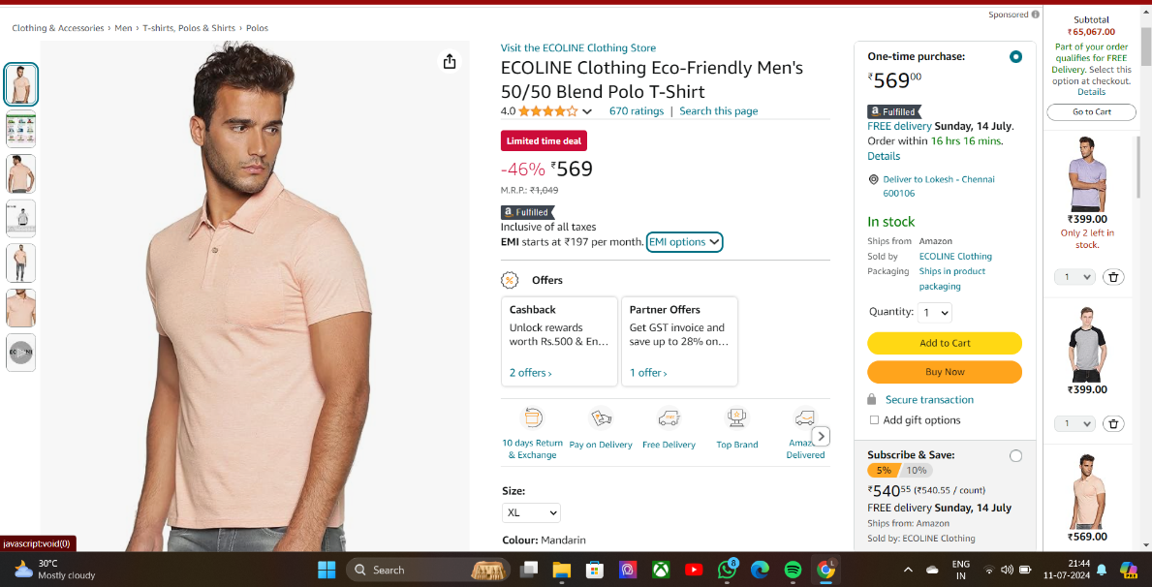
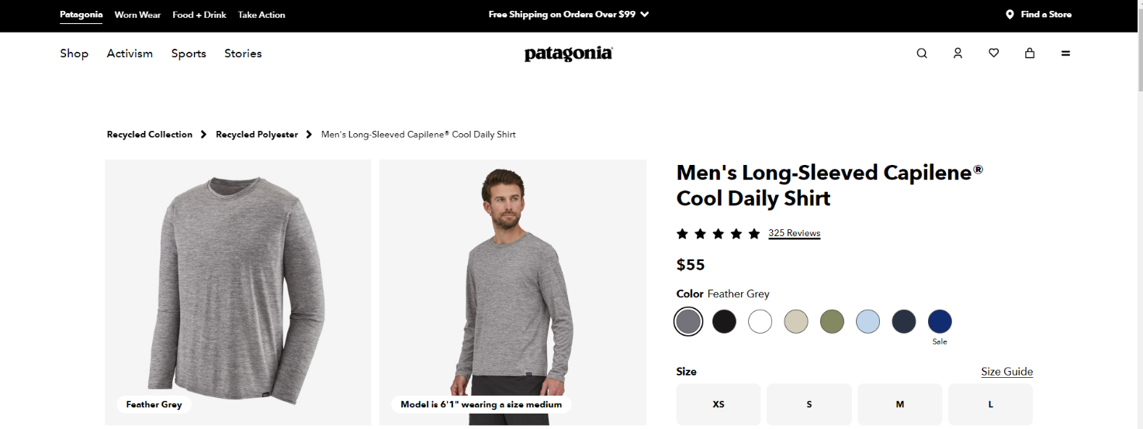
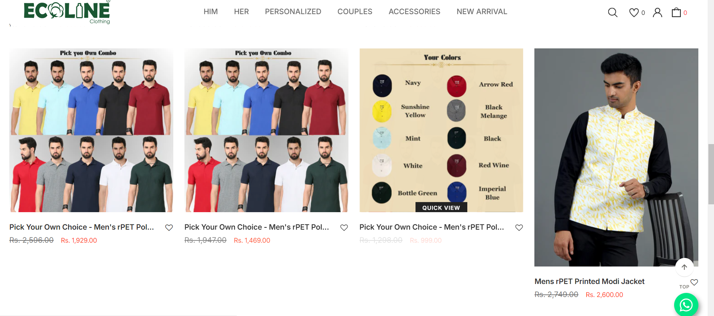
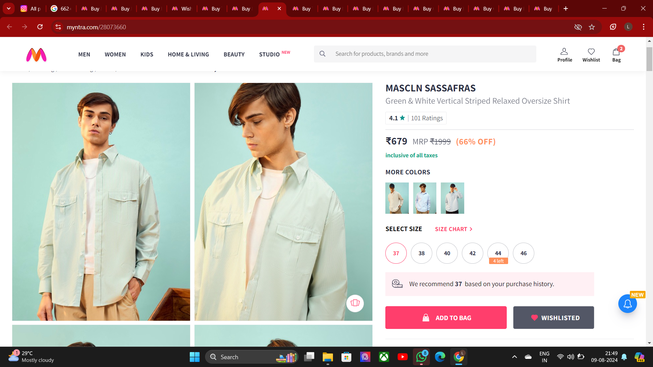
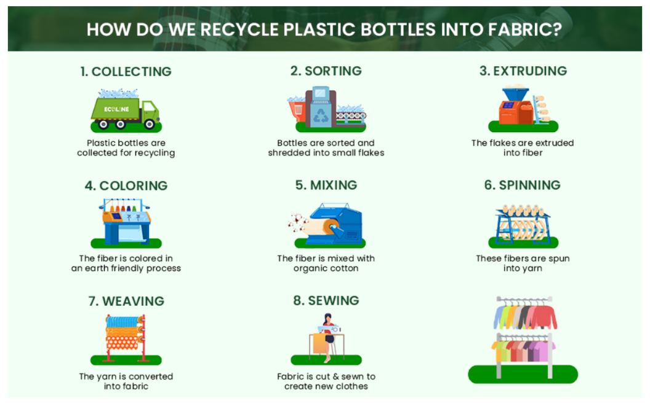
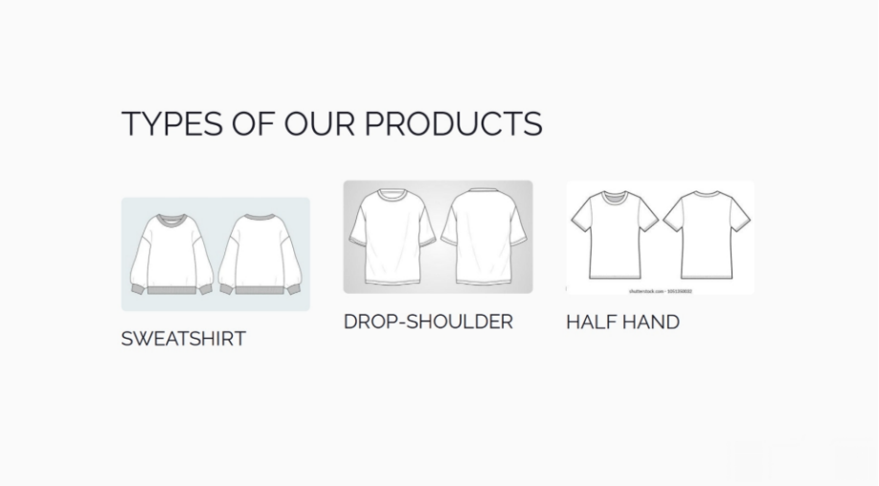
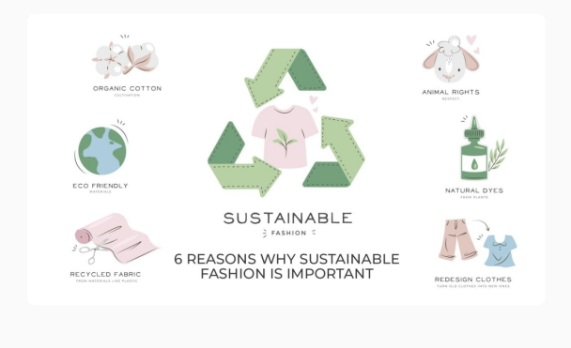
MVP
Existing product
Website 1: https://www.patagonia.com/shop/mens
Website 2: https://ecolineclothing.com

Slide 12
MVP Validation
What is your MVP
A monthly subscription box offering a curated selection of sustainable clothing items.
How long will we test this MVP?
3 months
Who is our target audience for the test? How many of them?
Eco-conscious consumers aged 25-45 who value ethical fashion and convenience.
Problem Solved: Provides a hassle-free way to incorporate sustainable clothing into their wardrobe while reducing the need for fast fashion.
Test Details
Test Duration: 3 months
Target Audience: 100 subscribers from the specified demographic
Recruitment: Social media advertising, influencer partnerships, and email marketing
Results of Test
Sales: 80% of subscribers renewed their subscriptions after the initial month.
Pricing: Customers were generally satisfied with the price point, with some expressing a desire for more affordable options.
Customer Loyalty: 65% of subscribers referred the service to friends and family.
Engagement: Subscribers actively participated in online communities and shared photos of their outfits on social media.
Realizations/Insights
The subscription model is a viable approach for reaching the target audience.
Pricing is a factor that could be further optimized to attract a wider range of customers.
Social media engagement is a valuable tool for building brand awareness and fostering customer loyalty.
Conclusion:
REALIZATION
Customer Feedback: Identify recurring themes and areas for improvement based on customer feedback.
Market Fit: Check if the MVP addresses key needs and stands out from competitors.
Pricing: Evaluate if the price aligns with perceived value and supports your revenue goals.
Engagement: Review repeat usage and customer journeys to find and fix friction points.
Persevere
Pivot
Not conclusive

Slide 13
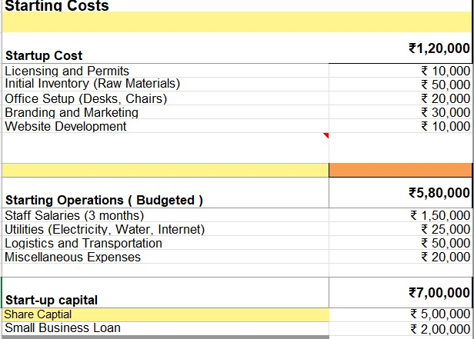
FINANCIAL PLAN

Slide 14
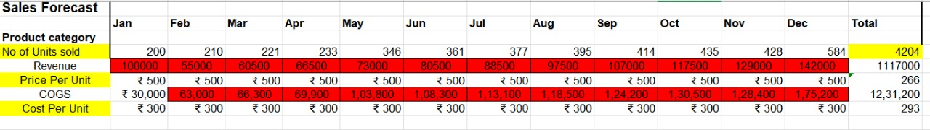
Sales Forecast

Slide 15
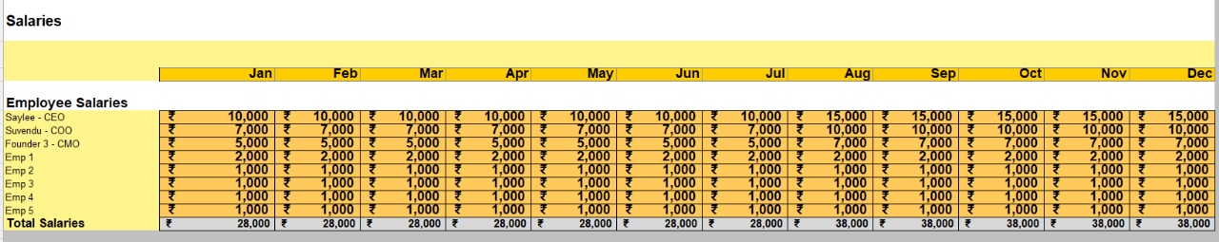
salaries

Slide 16
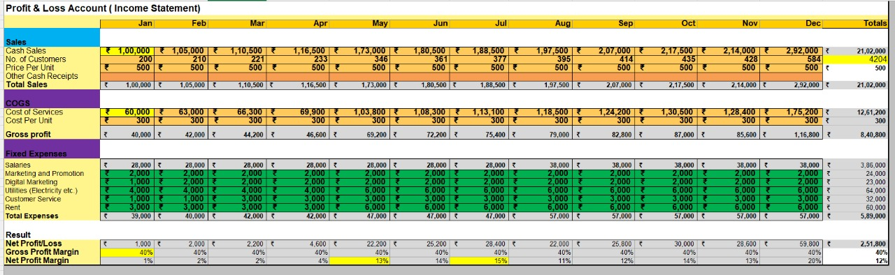
Forecast P&L

Slide 17
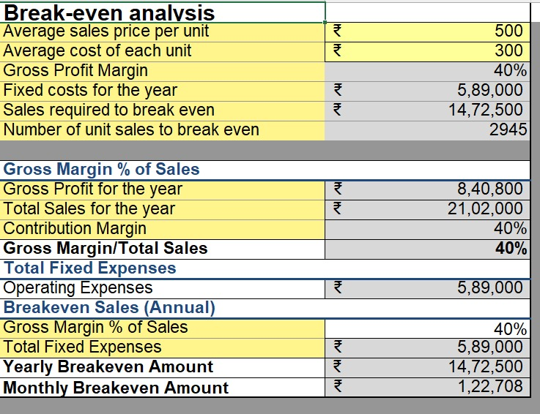
Break-Even analysis

Slide 18
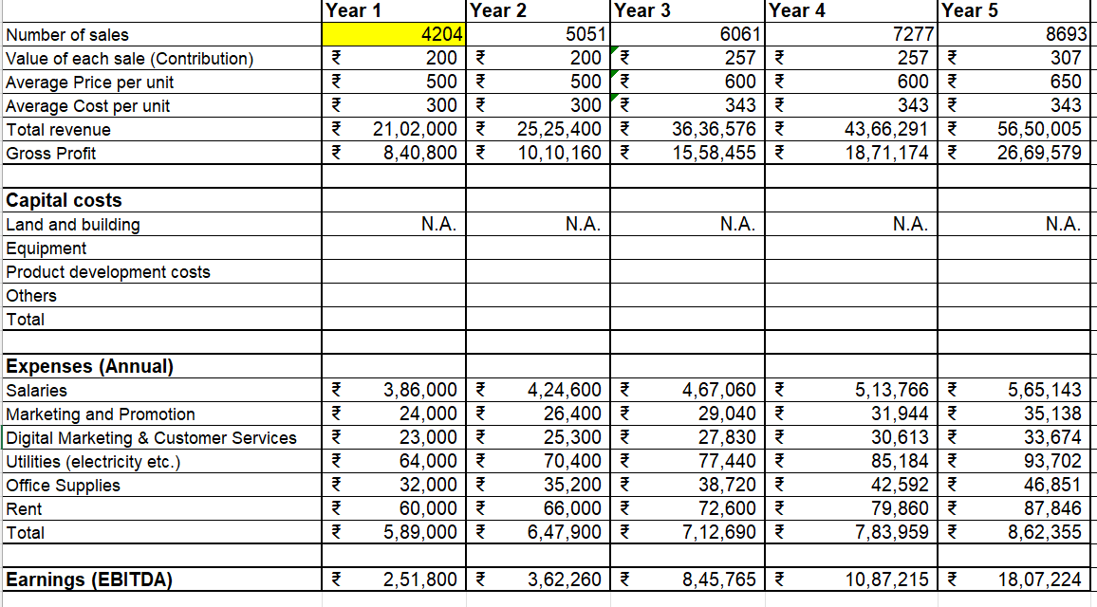
Funding

Slide 19
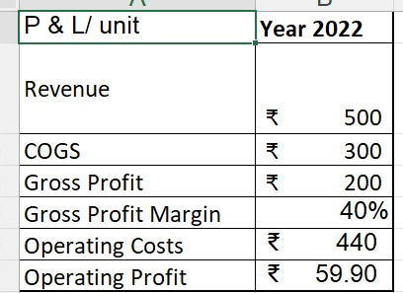
Unit Economics

Slide 20
Go-to-Market Strategy
1. Social Media Presence
Platforms: Actively use Facebook, Instagram, LinkedIn, and Twitter to build brand awareness and engage customers.
Content: Share posts on sustainability, product features, and customer stories to drive engagement.
2. Branding Video
Key Focus: Create a short, engaging video showcasing the brand’s story, eco-conscious values, and affordable fashion.
Distribution: Share it across social platforms and your website to maximize visibility.
3. Positioning Statement
Product Definition: A sustainable fashion brand offering second-hand shoes and clothes.
Value Proposition: Affordable, stylish, eco-friendly fashion for conscious consumers.
4. Sales & Distribution Model
Sales Channels: E-commerce website, social media shops (Instagram, Facebook), third-party platforms (Poshmark, eBay), and pop-up stores.
Distribution: Use eco-friendly logistics and packaging, supported by efficient inventory management.
5. Action Plan (Next 1 Year)
Target: Set clear monthly customer acquisition and sales goals.
Marketing: Run campaigns during key fashion seasons and use referral/loyalty programs to drive growth.

Slide 21
Sales Plan
Customer Sales Funnel
Customer Acquisition Plan
TARGET MARKET:
1,00,000 Eco-conscious millennials, ages 18-35, urban areas
OPPORTUNITIES/PROSPECTS:
5,000 inquiries via website, emails, and social media
CUSTOMER:
1,000 paying customers annually
LEADS:
10,000 social media followers and website visitors
1 | 2 | 3 | 4 | 5
Target Customer Segment (Type) | Target Customer Segment (Number) | Channels to be used to attract the target customer segment | Estimated number of leads | Estimated cost to convert these leads to actual customers
Millennials interested in sustainability | 50,000 | Instagram, Facebook ads, Google Ads | 10,000 | ₹2,00,000
Environment-conscious professionals | 10,000 | LinkedIn, email campaigns | 2,000 | ₹50,000
Students | 20,000 | Campus events, TikTok campaigns | 5,000 | ₹1,00,000
Retail partnerships | 5 retail partners | Trade shows, direct outreach | 500 leads | ₹1,50,000

Slide 22
Funding Plan
How much funds required to reach to the next level of the venture?
To scale Revived Goods, an estimated $50,000 - $100,000 may be required. This would cover costs related to expanding online marketing efforts, increasing inventory, improving logistics, hiring key personnel, and boosting brand visibility through influencer partnerships and pop-up stores.
How much have been bootstrapped? If not, why ?
Revived Goods has been bootstrapped with approximately $10,000, which has been used for website development, initial inventory, and marketing campaigns. If bootstrapping hasn't fully happened yet, the reason might be to conserve personal savings and mitigate risks until the proof of concept gains more traction.
How much can be bootstrapped?
Bootstrapping can continue up to $15,000 - $20,000 from personal savings or reinvesting profits from early sales. This will help cover operational costs for the next few months without external funding.
How much external funding required? If not, why?
An additional $50,000 in external funding would be beneficial to scale operations faster, especially for marketing, inventory expansion, and hiring. If external funding isn't sought yet, it could be due to a preference for bootstrapping to retain full control of the venture or until reaching a more validated market fit.

Slide 23
Funds utilization strategy
Investment in digital marketing (social media ads, influencer collaborations)
Create professional branding materials (videos, website optimization)
Sponsorships for eco-friendly fashion events or pop-ups
Purchase of second-hand clothes and pet bottles
Procurement of eco-friendly packaging materials
Improving the website (UI/UX) and adding e-commerce functionality
Integrating with third-party platforms like eBay or Poshmark
Establishing partnerships with eco-friendly logistics providers
Inventory management and warehousing solutions
Hiring key staff such as marketing experts and operations managers
Training for sustainable fashion curation

Slide 24
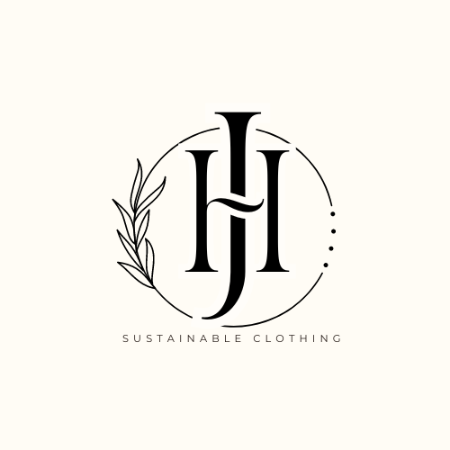


AUTHOR
Place your logo here
Place your logo here
LOKESH VARAN N
Key Strengths and abilities
Visionary Leadership
Strategic Thinking
Technical Expertise
Sustainability Focus
Effective Communication
Adaptability and Resilience
Team Leadership and Development
Picture
Role/Position:
CEO

Slide 25

Thank You!

